Slide 1
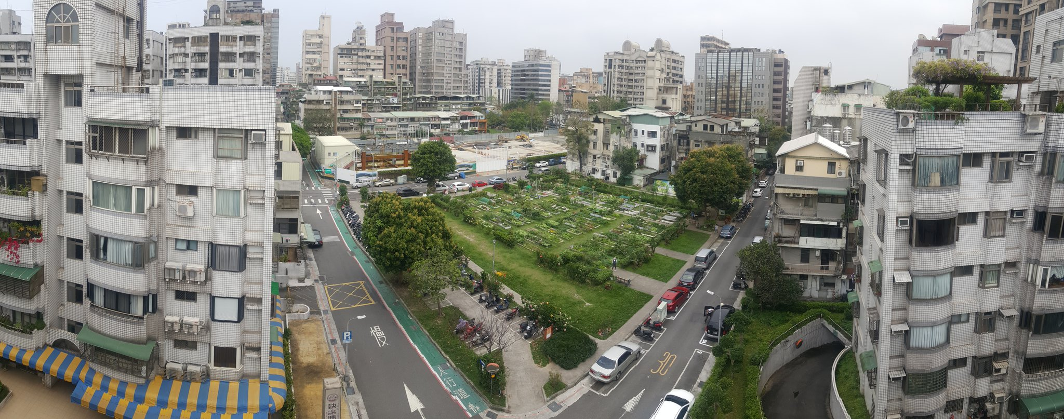
INNOVATIVE GOVERNANCE OF FOOD-WATER-ENERGY NEXUS IN CITIES
An IFWEN Training Program
How were innovative outcomes formed in the Taipei Garden City programme?
09 September - Government Solutions to Nexus Approaches
Wan-Yu Shih
Associate Professor
Department of Urban Planning and Disaster Management, Ming-Chuan University, Taiwan

Slide 2
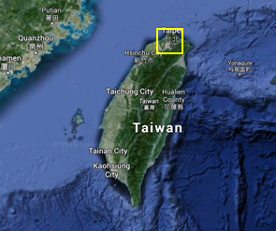
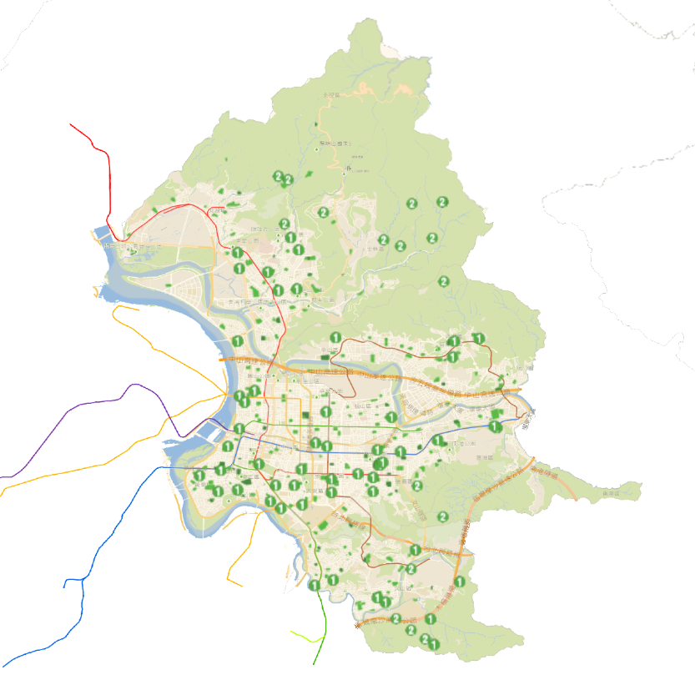
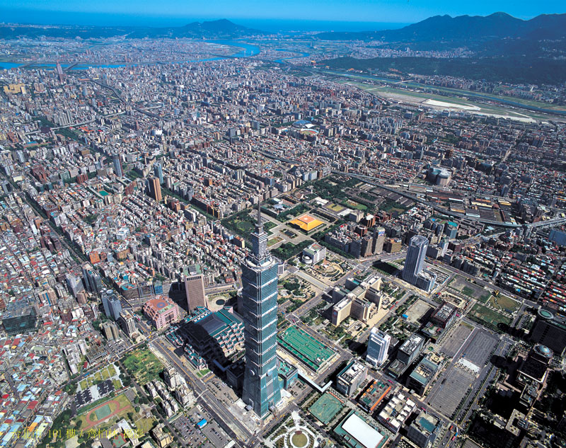
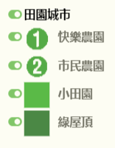
Taipei Profile
Location: North of Taiwan
Geography: Basin
Urbanized areas: 271.80 km2
Population: 2.67 million
Highest Pop. Density: 27,077 persons/km² (Da-an District)
Climate: Subtropical Summer(29.6℃); December (16.1℃)

Slide 3
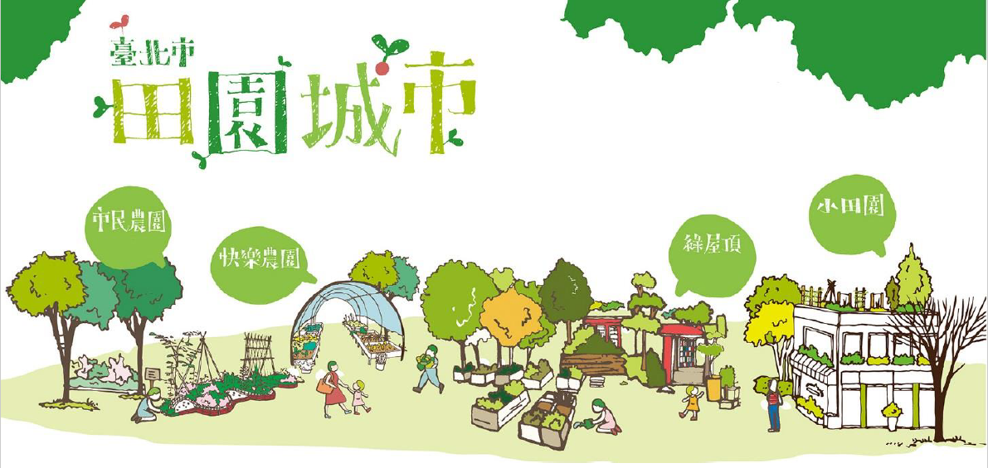
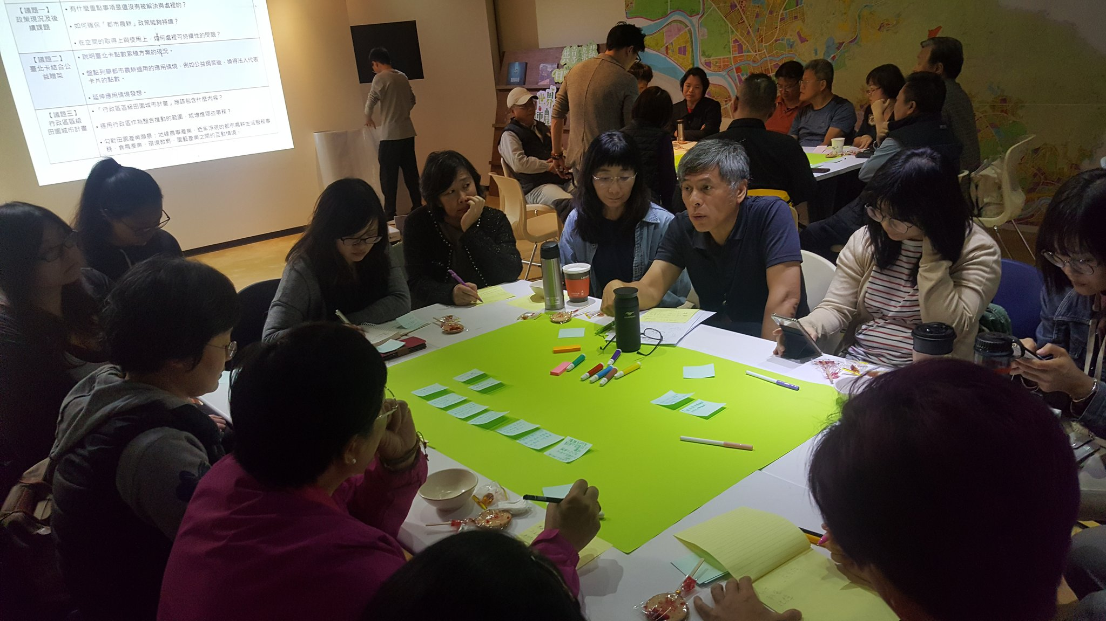
What is the Taipei Garden City Programme?
An urban farming movement involves bottom-up/top-down dynamics over time
Initiated by a group of local NGOs in Taipei and made policy appeals to the mayor in 2014.
The government forms active public-private partnerships.

Slide 4
Garden types
Since 2015, 733 sites have been established, covering 19.75 ha and involving in 54,013 citizens (as of Feb 2020).
Happy gardens (95, 30%)
Disused public lands on the ground
Local communities
City centre
Multiple benefits
Non-commercial
Green roofs (62,11%)
Rooftop of public buildings
Local communities/staffs
City centre
Multiple benefits
Non-commercial
School gardens (284 ground and 253 rooftop, 45%)
Grounds and rooftops of schools
Teachers and students
City centre
Environmental education
Non-commercial
Allotment gardens (14%)
Larger privately-owned lands
Agriculture zones
City outskirt
Food production
Commercial to recreation

Slide 5
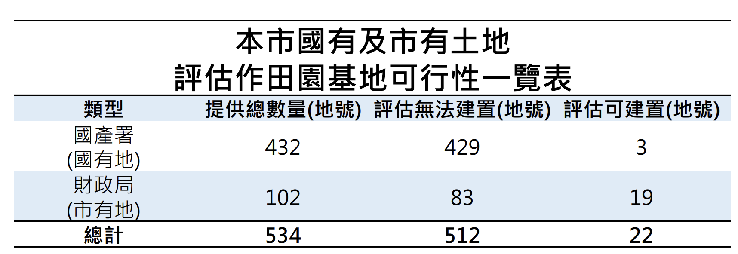
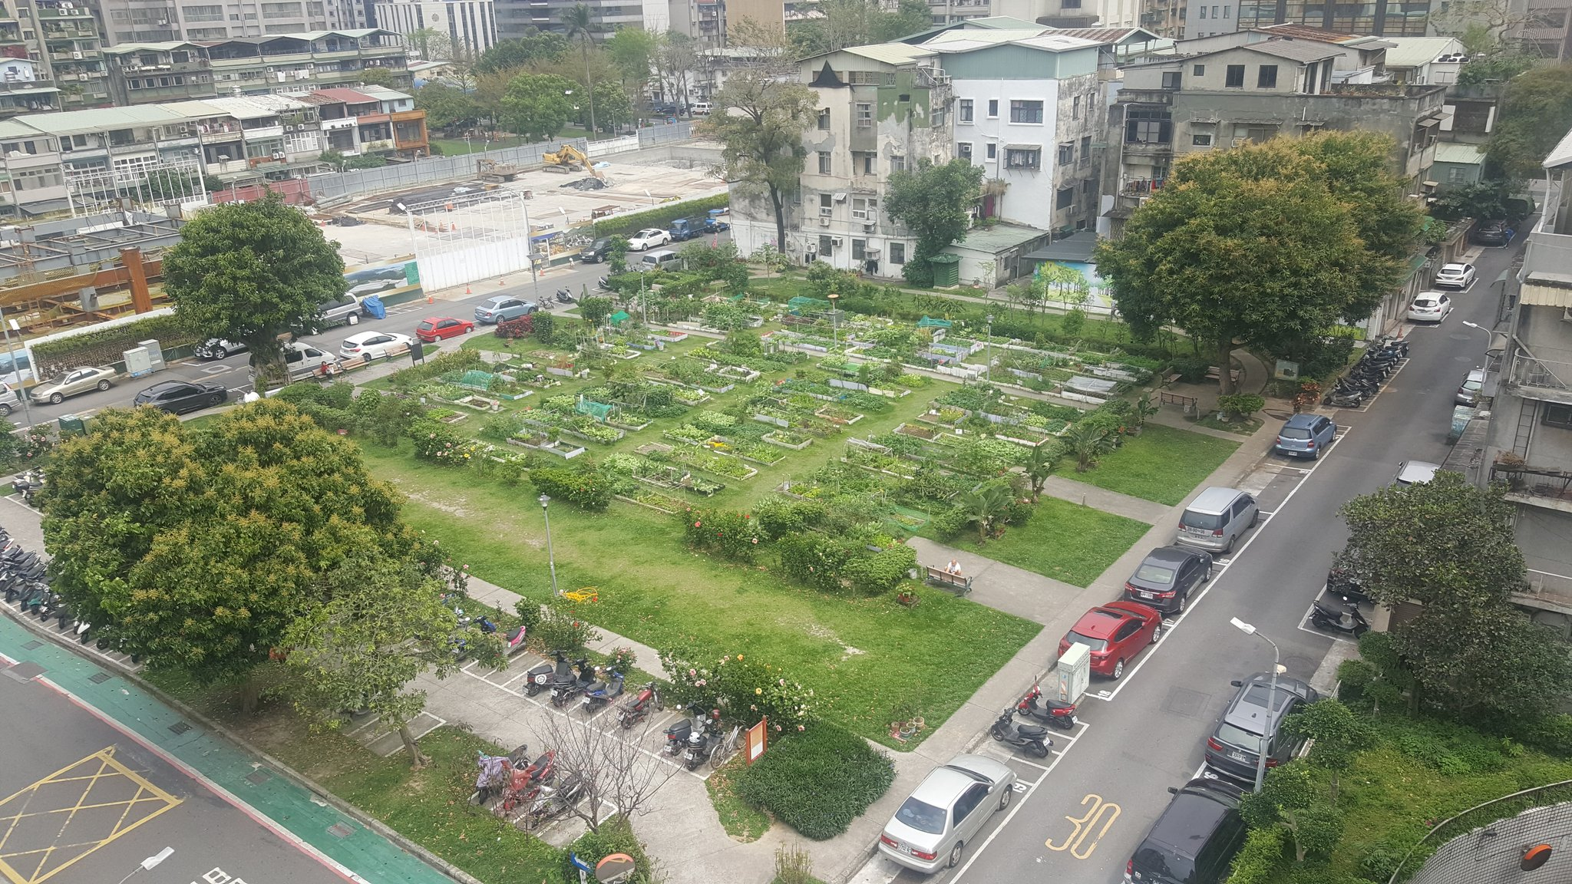
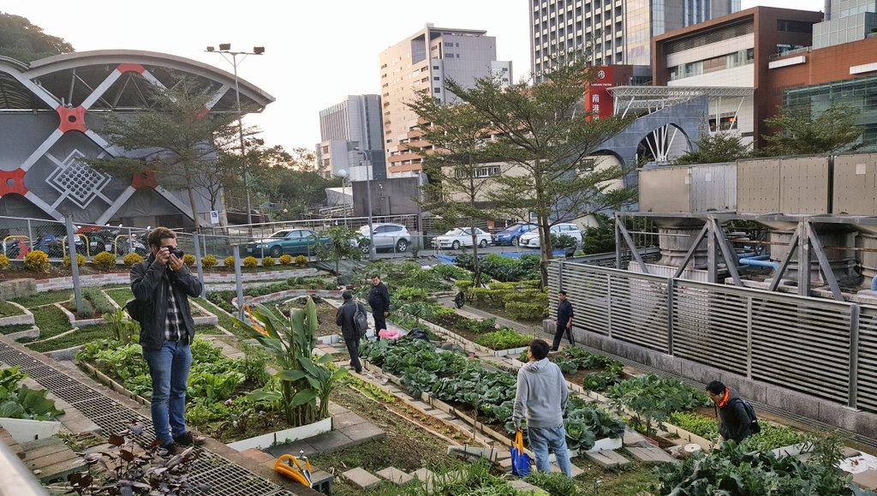
Innovation Area: Making use of (temporarily) vacant and public owned land near to urban residents.
Lifting land use ban on publicly-owned lands for temporary use before construction.
City-wide inventory of suitable land.

Slide 6
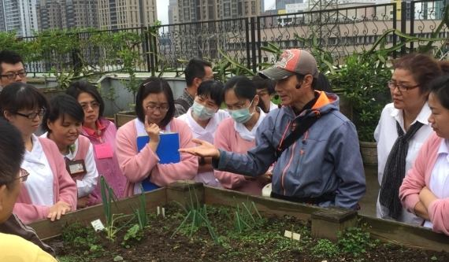
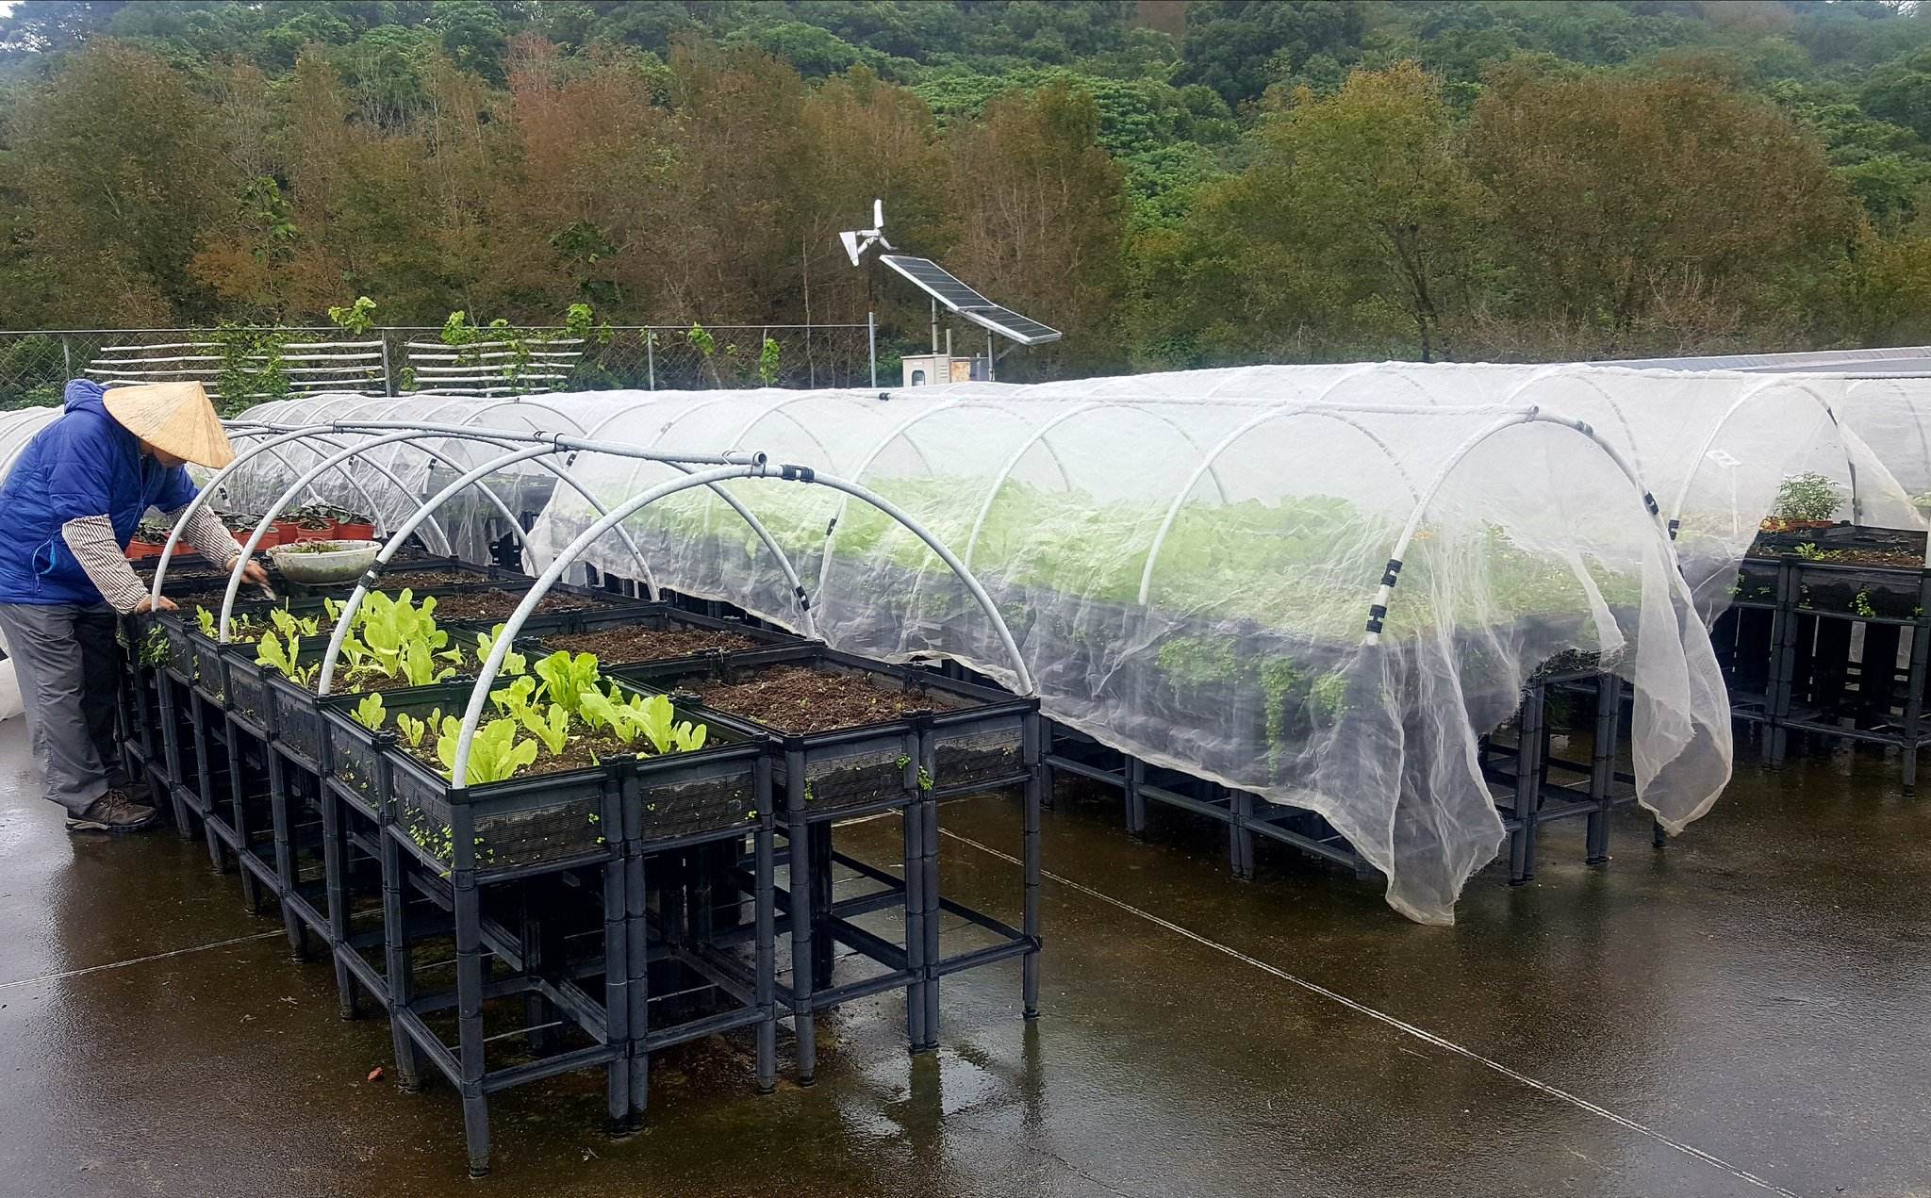
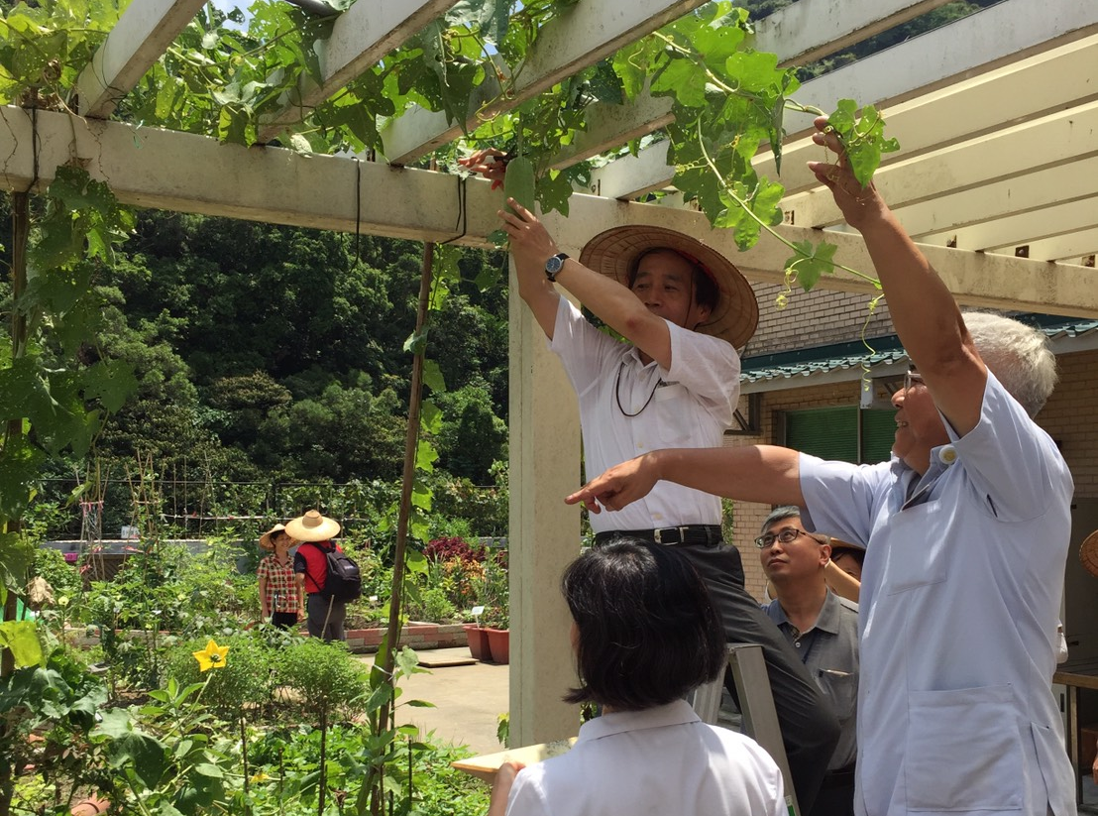
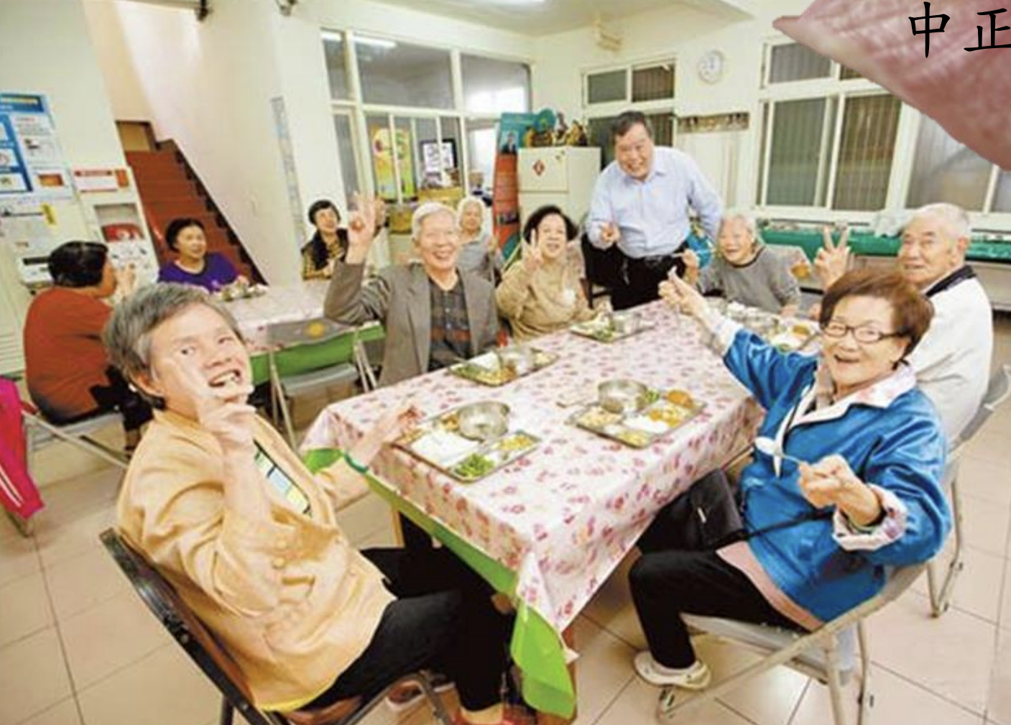
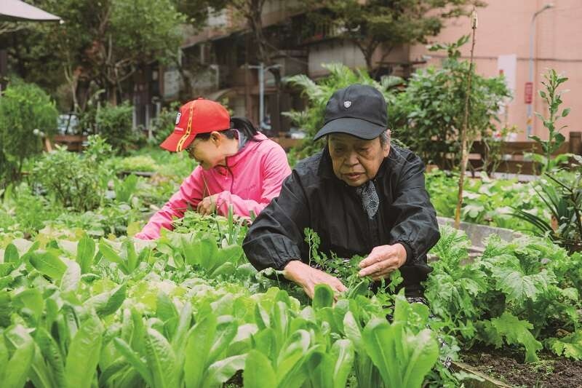
Innovation Area: empowering local communities and connecting to social problems and community characteristics
Horticultural therapy at hospitals
Social care for elderly & disadvantaged communities

Slide 7
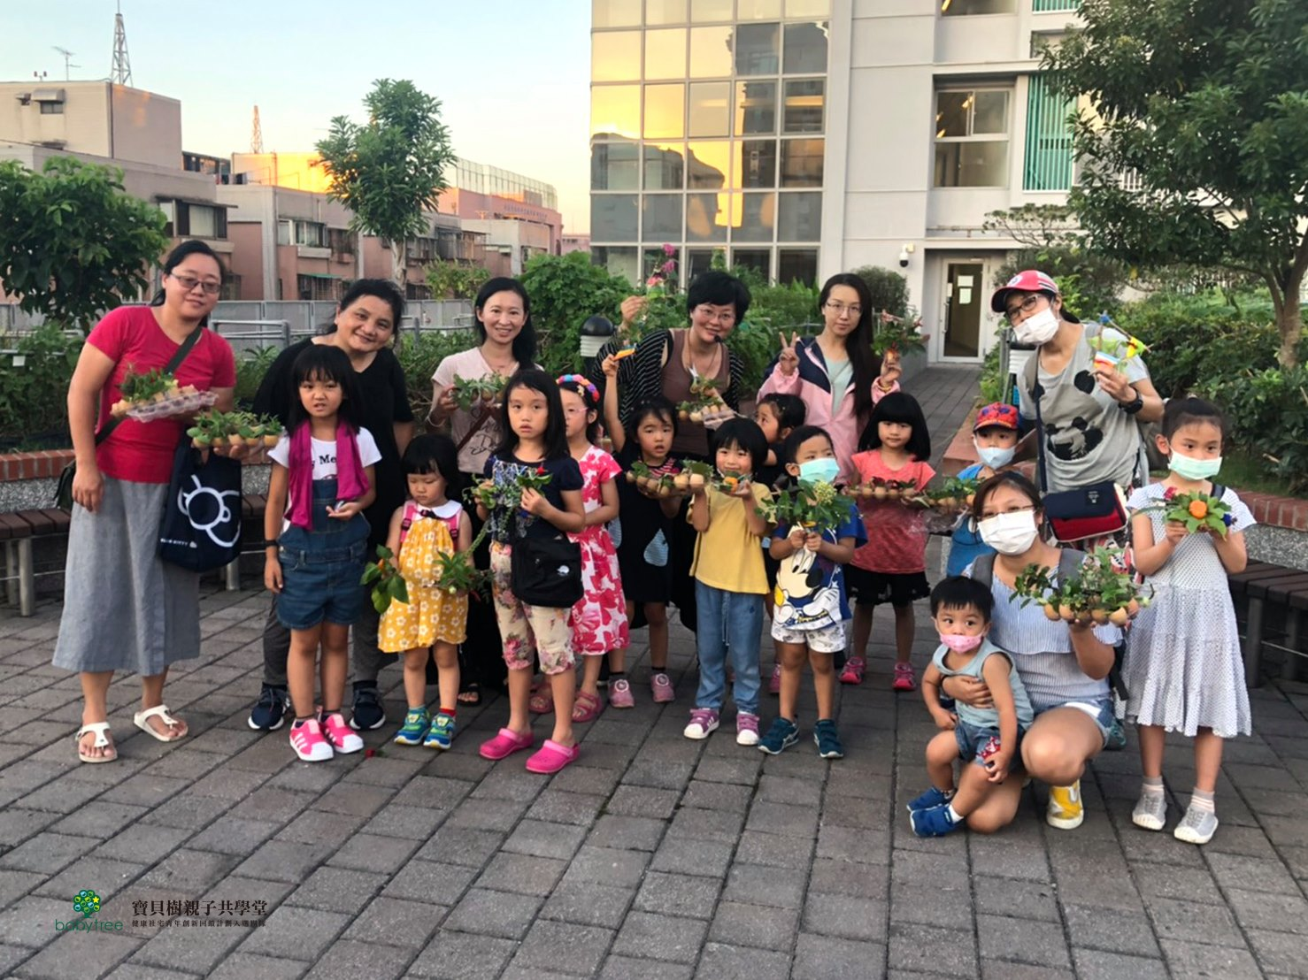
Youth start-up scheme at social housing

Slide 8
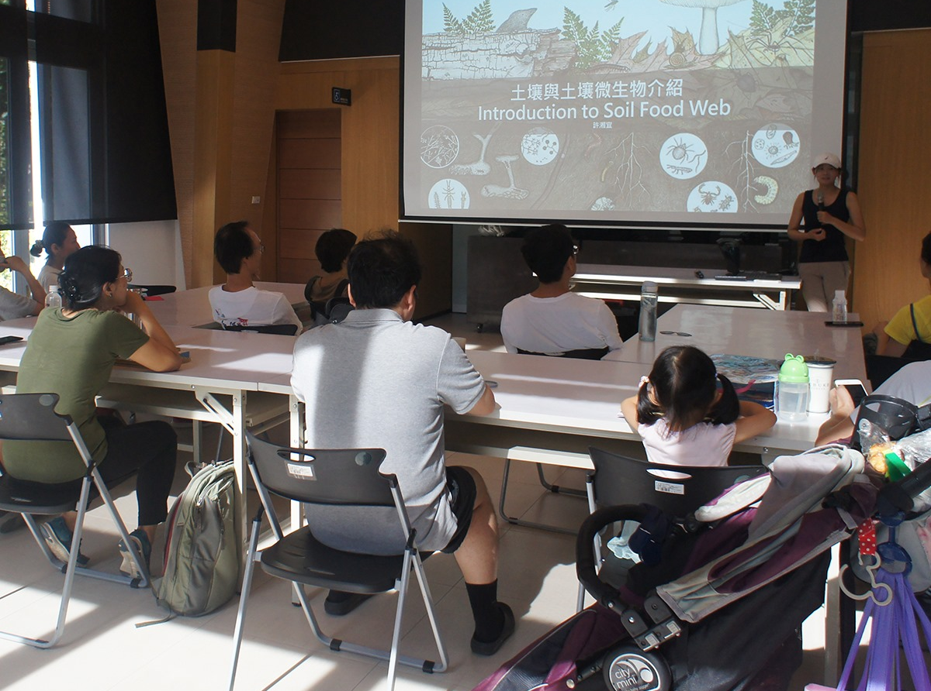
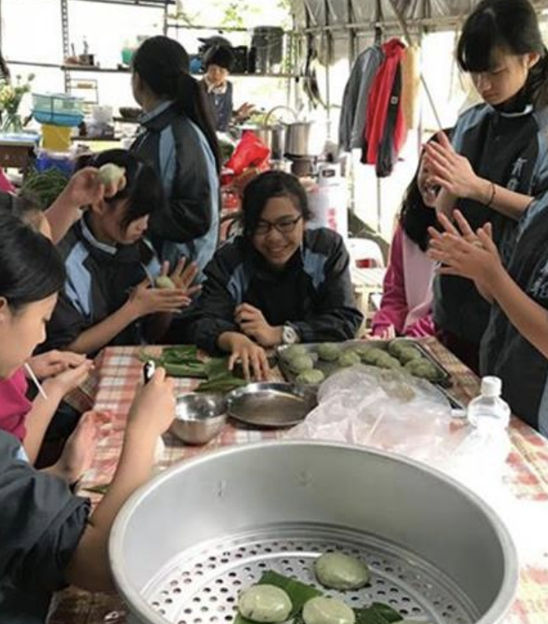
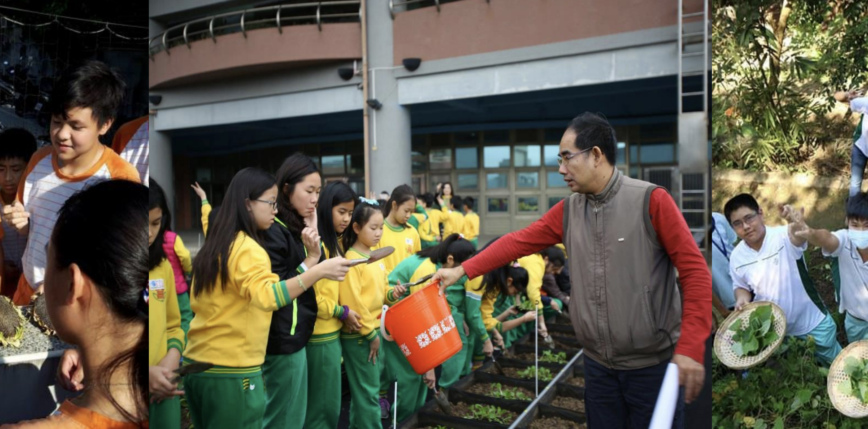
Environmental Education

Slide 9
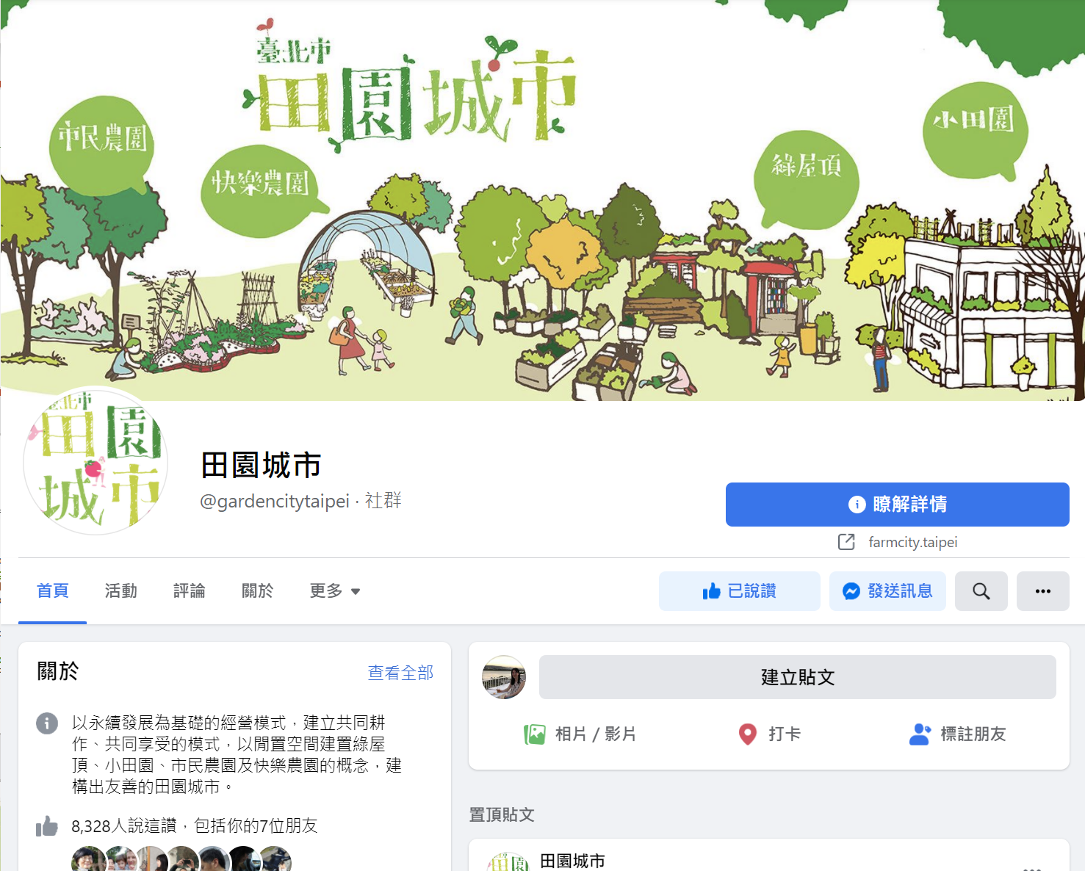
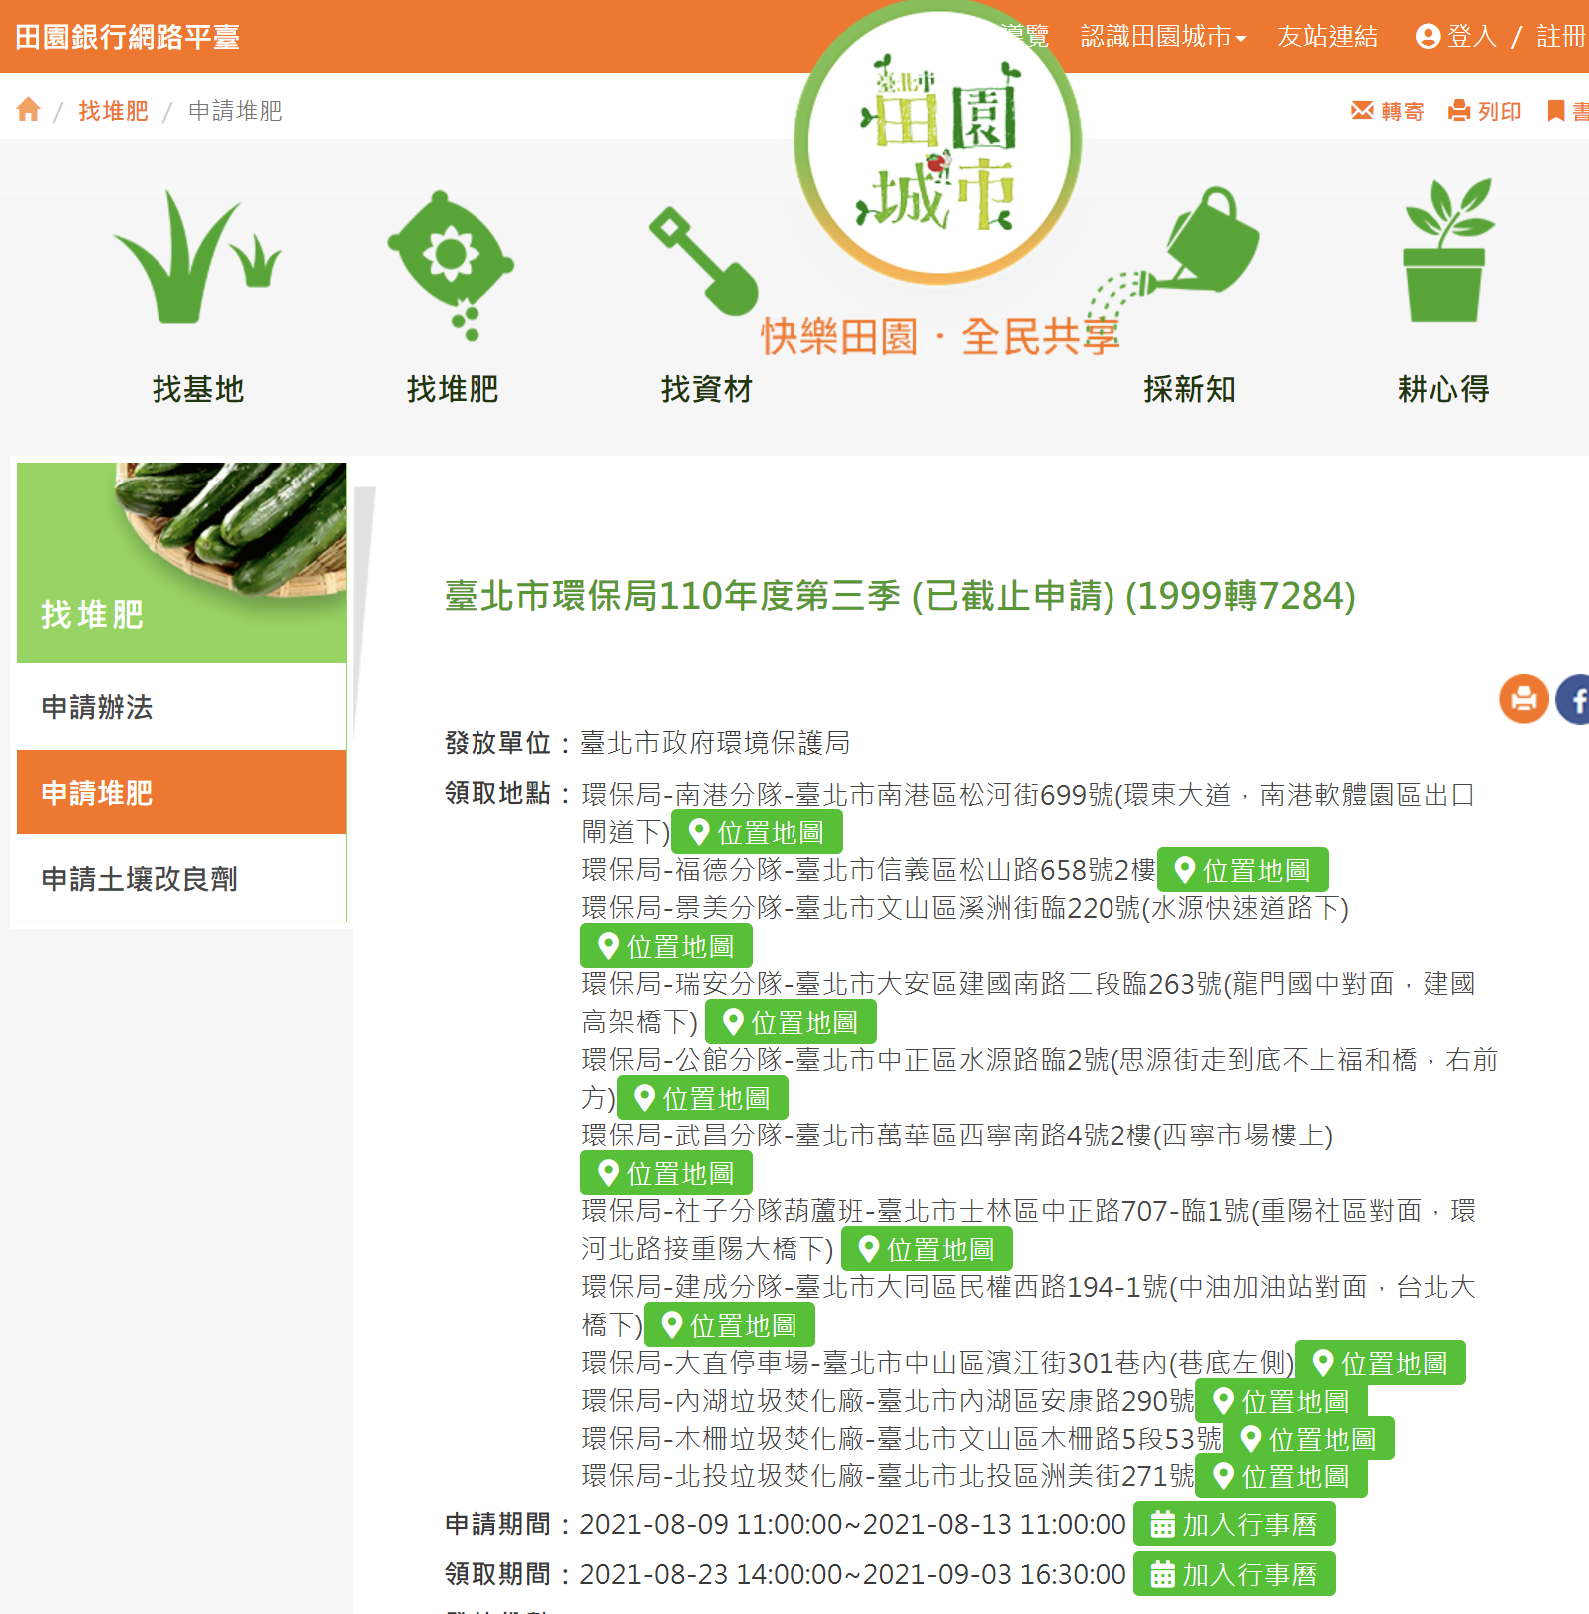
Innovation Area: the use of online platform for sharing information and engaging people.

Slide 10
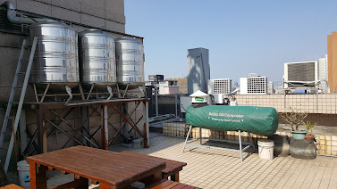
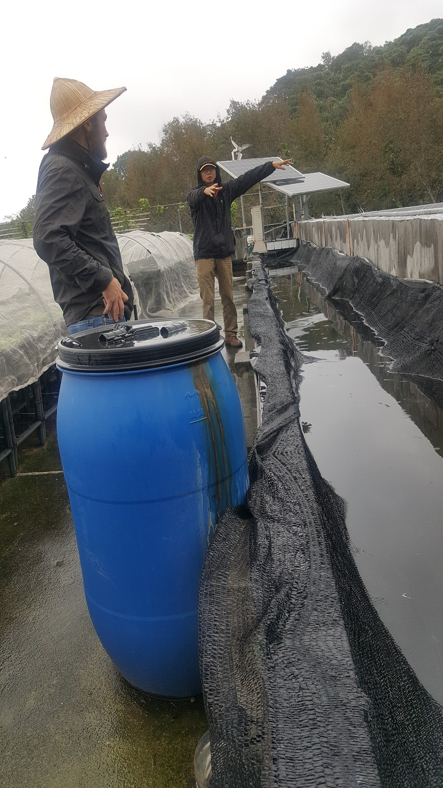
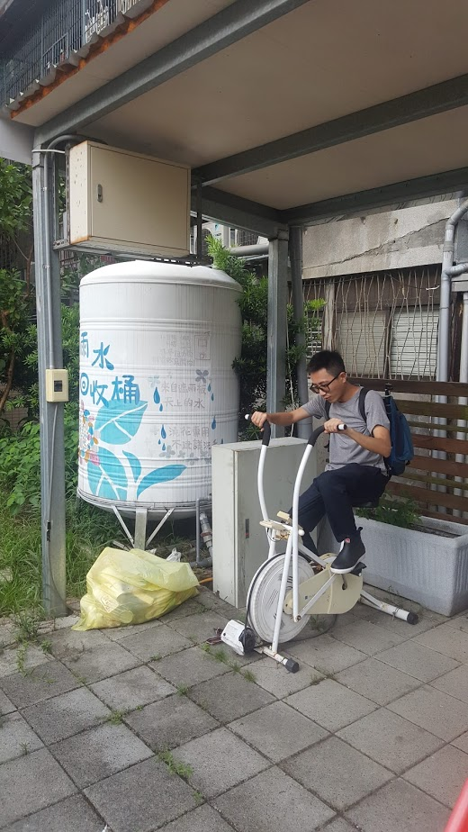
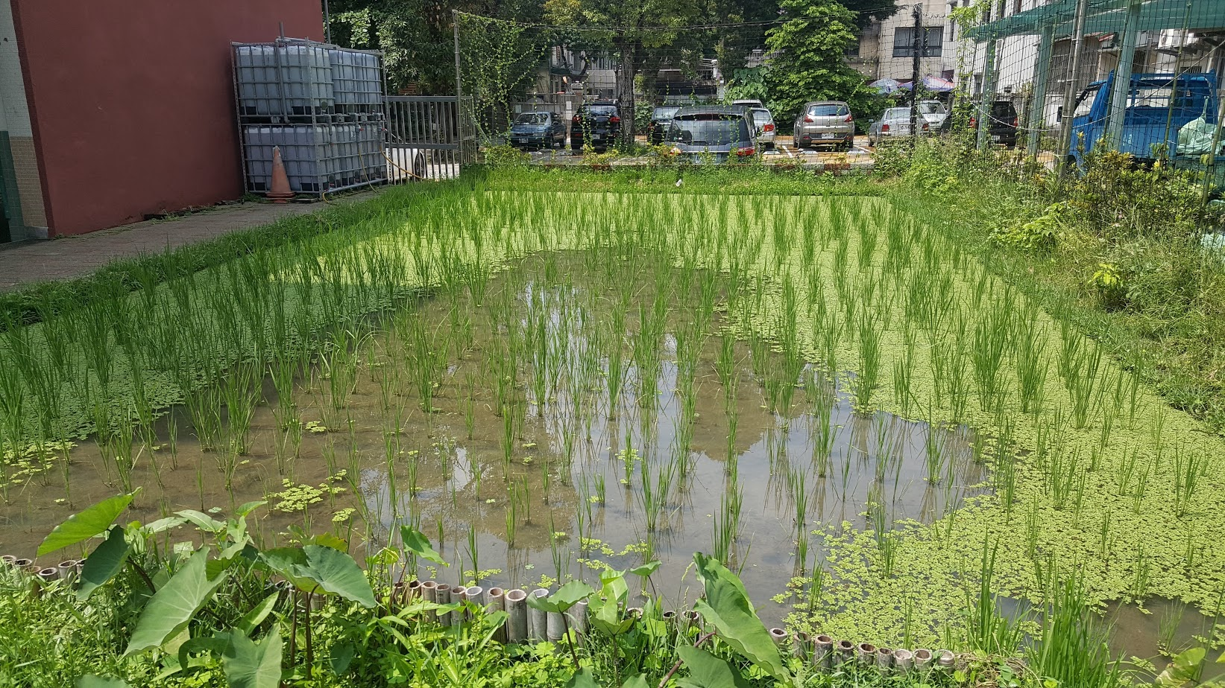
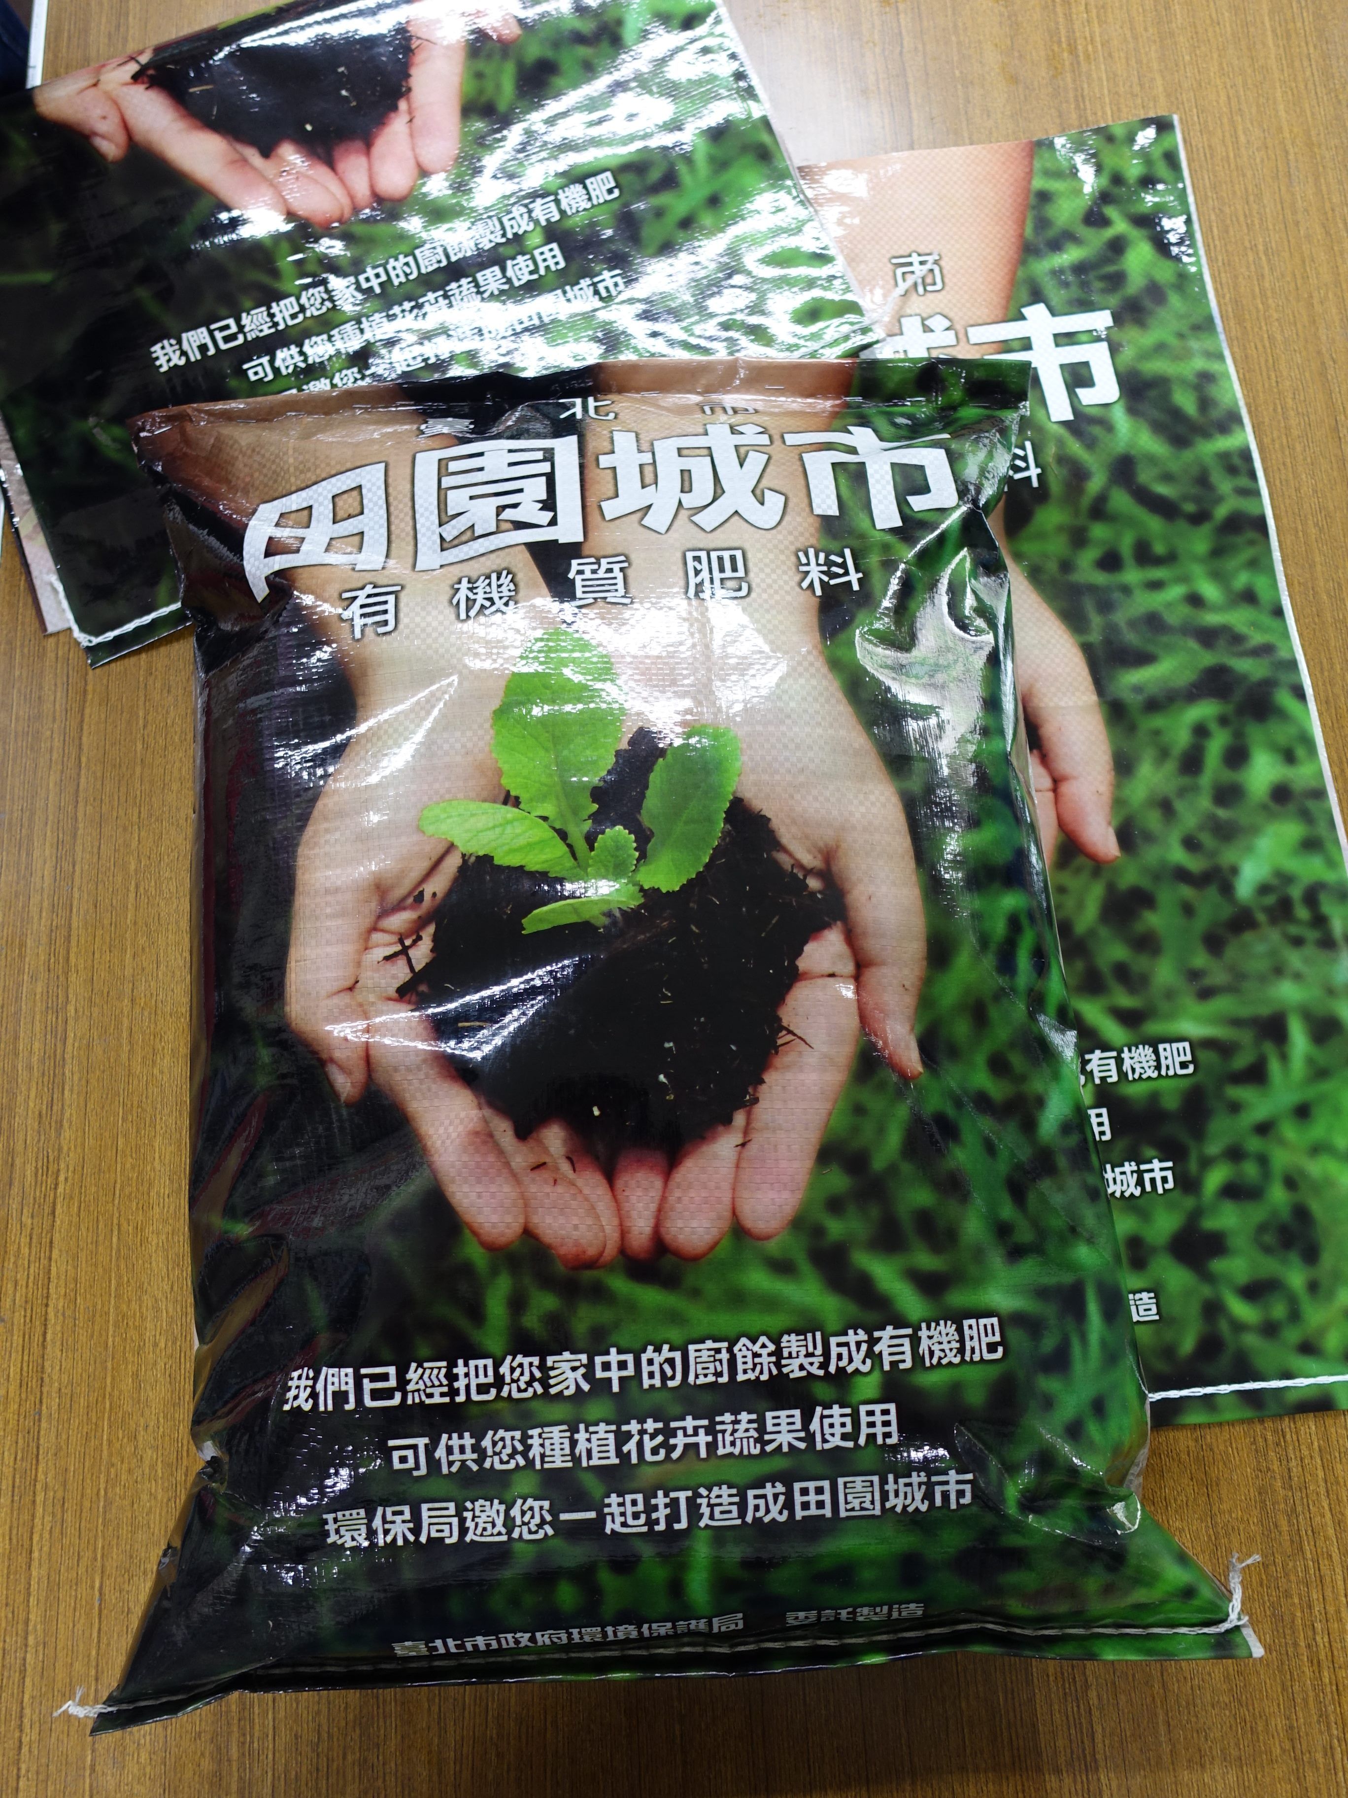
Innovation Area: encouraging sustainable, ecological and environmental friendly actions in the locality
Permaculture;
Sheet mulching;
Harvested water;
Organic cultivation;
Composting…

Slide 12
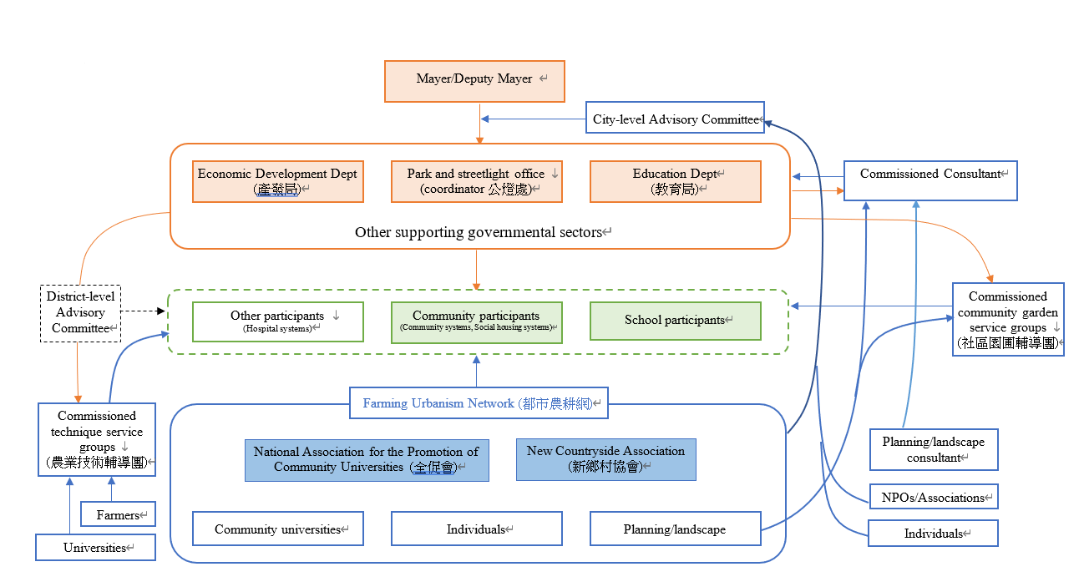
Governance Nexus of Taipei Garden City Programme

Slide 13
