Slide 1
WP2 (presented in Sao Paulo in 09/2019)
Fig 2: Conceptual framework for the effects of GBI on the FWE nexus in cities.

Slide 2
Edible Urban Greenspaces: Scope WP6 (presented in Sao Paulo in 09/2019)
Agriculture lands
Agriculture lands
Allotments
Parks
Gardens
Formal parks and greenspaces
Greenspaces (including forests)
Urban Agriculture
Riverside
Informal greenspaces
Roadside
Non-agriculture lands
School grounds
Other open spaces
Institutional grounds
Disused/vacant lands
Scope of edible greenspaces in literature
Rooftops
Buildings
Other vertical gardens

Slide 3
FWE of Edible Urban Greenspaces: Literature Review (WP6 (presented in Sao Paulo in 09/2019)
Food system is defined as “the chain of activities connecting food production, processing, distribution, consumption, and waste management, as well as the associated regulatory institutions and activities” (Pothukuchi, & Kaufman, 2000).
Nexus types | Description
Water to food | Irrigation to plants | Rainwater
 |  | Grey water
 |  | Tap water
 |  | Waste water
Water to energy | Hydropower
Energy to water | Extracting water
 | Pumping water
 | Delivering water
 | Water treatment
Energy to food | Transportation (food mile) | Transporting materials (seeds, fertilizers, compost) from markets
 |  | Food transport to markets
 |  | Food delivery to consumers
 | Building operation
 | Logistical and storage process for food production
Food to water | Runoff retention
 | Surface water drainage
Food to energy | Regulation of micro-climate (cooling) and reduce energy consumption
 | Bioenergy

Slide 4
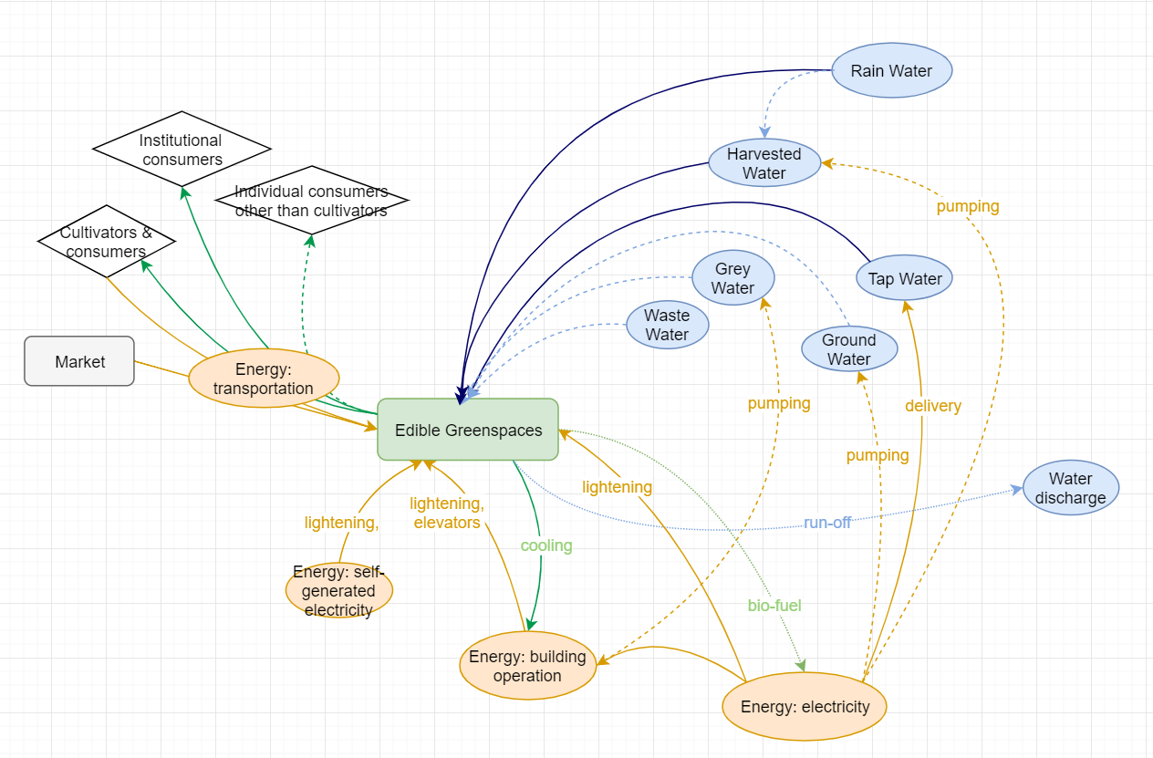
Mapping Approach for FEW Dynamics of the Edible GSs in Taipei (WP6 (presented in Sao Paulo in 09/2019)
Conceptual framework based on expert interview, documentary review, and site observation.

